Slide 1
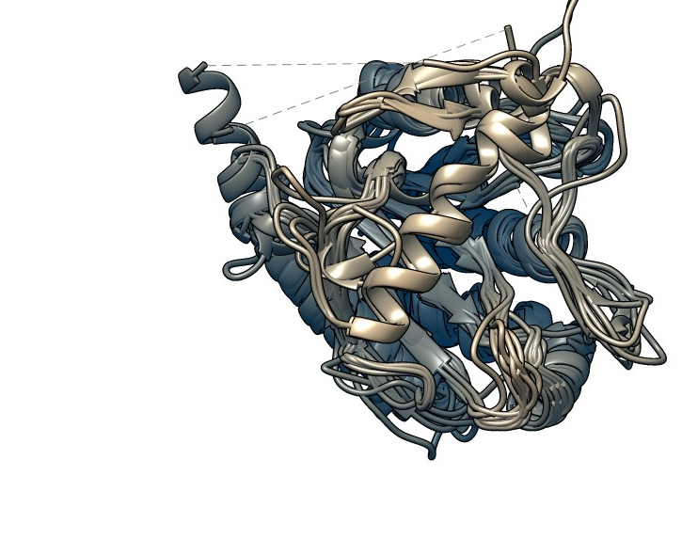
Update
09/06/2023

Slide 2
Amidase_3 Structures
How accurately are these assigned? (19 identified via annotations)
Bacterial 3 (AmiB) | Bartonella henselae | - | NAMLA amidase of Bartonella henselae str. Houston-1 | 3NE8 | A | 2010 | ACETATE ION, FORMIC ACID, GLYCEROL, Zn²⁺ | BLASTp search 1 (restricted to PDB, FASTA seq. search of 4BIN)
Bacterial 3 (AmiC) | Escherichia coli | - | E. coli N-acetylmuramoyl-L-alanine amidase AmiC | 4BIN | A | 2013 | Zn²⁺ ,Na⁺ | PDB search for AmiC
Bacterial 3 | Neisseria meningitidis | - | putative N-acetylmuramoyl-L-alanine amidase from Neisseria meningitidis | 3CZX | A | 2008 | Zn²⁺ | PDB search of Amidase_3 protein family annotation
Bacterial 3 | Thermus parvatiensis | NA | AmiP amidase-3 from Thermus parvatiensis - PHAGE | 7B3N | A | 2020 | Zn²⁺, Na⁺, Cl⁻, Glycerol, SO₄²⁻, Ethanesulfonic Acid | BLASTp search 1 (restricted to PDB, FASTA seq. search of 4BIN)
Bacterial 3 | Bacillus( Paenibacillus polymyxa) | NA | Catalytic domain of CwlV, N-acetylmuramoyl-L-alanine amidase from Bacillus(Paenibacillus) polymyxa var.colistinus - PHAGE | 1JWQ | A | 2001 | Zn²⁺ | BLASTp search 1 (restricted to PDB, FASTA seq. search of 4BIN)
Bacterial 3 | Clostridium difficile | + | Cwp6 from Clostridium difficile | 5J72 | A | 2016 | Citric Acid, Zn²⁺, Ca²⁺, Cl⁻, Na⁺ | BLASTp search 1 (restricted to PDB, FASTA seq. search of 4BIN)
Bacterial 3 | Clostridium difficile | + | The crystal structure of N-acetylmuramoyl-L-alanine amidase from Clostridium difficile 630 | 4RN7 | A | 2014 | Zn²⁺, Formic Acid, Glycerol, EPE (Ethanesulfonic Acid) | BLASTp search 1 (restricted to PDB, FASTA seq. search of 4BIN)
Bacterial 3 | Clostridium difficile | + | Structure of the CwlD amidase from Clostridioides difficile in complex with the GerS lipoprotein | 7RAG | B | 2021 | Zn²⁺, 1,2-Ethanediol | PDB search of Amidase_3 protein family annotation
Bacterial 3 | Clostridium difficile | NA | Catalytic domain of CD27L endolysin targeting Clostridium difficile | 3QAY | A | 2011 | SO⁴⁻, Zn²⁺ | PDB search of Amidase_3 protein family annotation
Bacterial 3 | Mycobacteroides abscessus | + | crystal structure of the N-acetylmuramyl-L-alanine amidase, Ami1, from Mycobacterium abscessus bound to L-Alanine-D-isoglutamine | 7AGO | A | 2020 | Zn²⁺, D-alpha-glutamine, Alanine | PDB search of Amidase_3 protein family annotation
Bacterial 3 | Mycobacteroides abscessus | + | crystal structure of the apo form of the N-acetylmuramyl-L-alanine amidase, Ami1, from Mycobacterium abscessus. | 7AGL | A | 2020 | Zn²⁺ | PDB search of Amidase_3 protein family annotation
Bacterial 3 | Mycolicibacterium smegmatis | + | Crystal structure of the N-acetylmuramyl-L-alanine amidase, Ami1, from Mycobacterium smegmatis | 7AGM | A | 2020 | Zn²⁺ | PDB search of Amidase_3 protein family annotation
Bacterial 3 | Nostoc punctiforme | + | N-acetylmuramoyl-L-alanine amidase AmiC2 of Nostoc punctiforme | 5EMI | A | 2015/2016 | MES, MRD, Zn2+ | BLASTp search 1 (restricted to PDB, FASTA seq. search of 4BIN)
Bacterial 3 | Staphylococcus aureus | + | Structure of the S. aureus amidase LytH and activator ActH extracellular domains | 7TJ4 | B | 2022 | Zn²⁺ | BLASTp search 1 (restricted to PDB, FASTA seq. search of 4BIN)
Bacterial 3 | Listeria monocytogenes | NA | Listeria monocytogenes bacteriophage PSA endolysin PlyPSA | 1XOV | A | 2004 | Cl- ,GLUTAMIC ACID, LYSINE, 2-AMINO-2-HYDROXYMETHYL-PROPANE-1,3-DIOL, SO⁴⁻, Zn²⁺ | PDB search of Amidase_3 protein family annotation
Bacterial 3 | Mycobacterium tuberculosis | NA | Mycobacterium tuberculosis peptidoglycan amidase Rv3717 in complex with L-Alanine-iso-D-Glutamine reaction product | 4M6G | A | 2013 | Zn²⁺ | PDB search of Amidase_3 protein family annotation
Bacterial 3 | Mycobacterium tuberculosis | NA | Crystal structure of Rv3717 reveals a novel amidase from M. tuberculosis | 4LQ6 | A | 2013 | SO⁴⁻, Zn²⁺, Cl⁻, Pt²⁺ | PDB search of Amidase_3 protein family annotation
Bacterial 3 | Mycobacterium tuberculosis | NA | Structure of the reduced, Zn-bound form of Mycobacterium tuberculosis peptidoglycan amidase Rv3717 (metal-free structure: 4M6H) | 4M6I | A | 2013 | Zn²⁺ | PDB search of Amidase_3 protein family annotation
Bacterial 3 | Mycobacterium tuberculosis H37Rv | NA | Structure of the reduced, metal-free form of Mycobacterium tuberculosis peptidoglycan amidase Rv3717 | 4M6H | A | 2013 | None reported | PDB search of N-acetylmuramoyl-L-alanine activity (GO annotation)

Slide 3
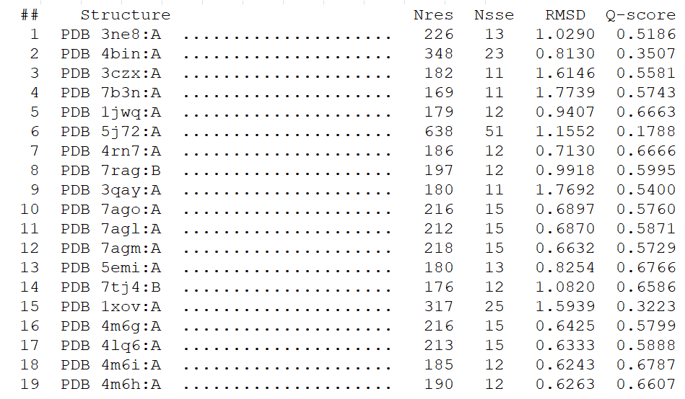
PDBeFOLD Multiple Alignments
Global multiple structure alignment (PDBeFOLD), examine conservation of structure in the 19.
Q-score: Alpha carbon backbone alignment (1=highest) and RMSD
Notes:
RMSD = Root mean square deviation (difference between prediction values and estimator. Close to 1 for backbone = good, larger than 6 indicates poor quality OR conformational changes in the protein.
Consensus RMSD=1.5525, Q-score of 0.1255

Slide 4
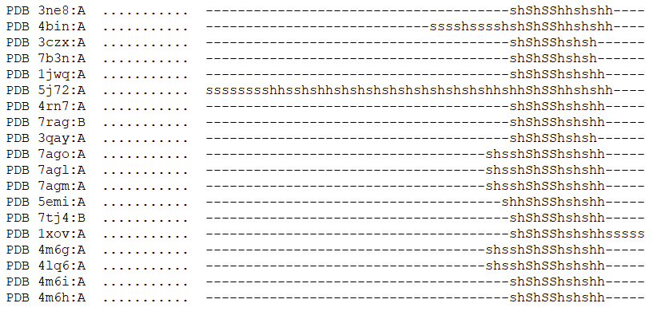
PDBeFOLD Multiple Alignments
Global multiple structure alignment (PDBeFOLD), examine conservation of structure in the 19.
Notes:
Conserved across all: Glycine-Histidine pair at end of first beta sheet (Gly195, His196), glutamate at start of first helix (Glu211), histidine at end of second sheet (4BIN HIS265), glutamate in sheet 5 (Glu373)
For two gram negatives, there is an additional helix between 289-307 for 4BIN and 280-298 for 3NE8 that isn’t there for the gram positives or the other gram negatives and does not align to anything in the MSA.
Mycobacteria have a region near the start of the amidase which isn’t conserved in any other species, region contains a helix and at least one beat sheet, region is in 7AGO, 7AGL, 7AGM, 4M6G, 4LQ6. Most, not all of the mycobacteria.
Mycobacteria do all have a 7 residue motif, residues not all in common however some are conserved (Tyr-Ile-Gly-X-X-Gly).
Bacteriophage amidase had very long C-terminal domain containing beta sheets after the amidase enzyme (did not align to anything, makes sense because all other structures are bacterial)

Slide 5
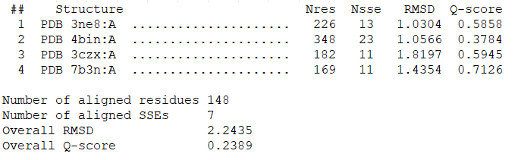
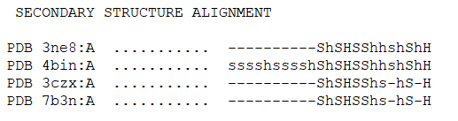
PDBeFOLD Multiple Alignments
Repeated alignment in gram negative
Notes:
Output 2: Gram negative alignment (4 structures, same settings as output 1)
RMSD 2.243 and Q-score 0.2389 for these (alignment is somehow worse just in gram negative amidases)
4BIN is the only one with an N-terminal part
Helix does not align with AmiP amidase or the Neisseria meningitidis NAMLA (This is actually a bacteriophage amidase AmiP, and AmiP is not typically classed with Amidase_3 enzymes when looking at the various domain databases like SMART)
Conservation of secondary structures across the 4 gram negatives
Hard to draw conclusions from this as very few crystal structures

Slide 6
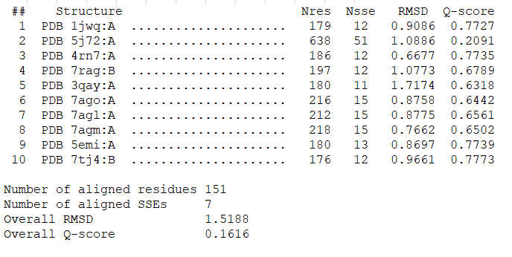
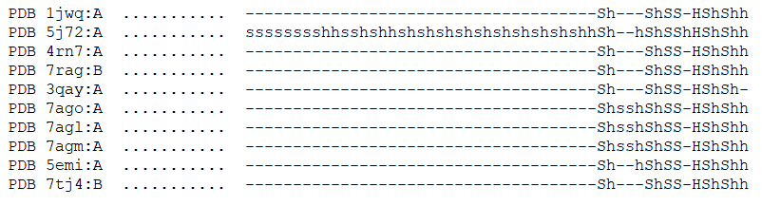
PDBeFOLD Multiple Alignments
Repeated alignment in gram positive
Notes:
Output 3: Gram positive alignment (10 structures, same settings as output 1)
RMSD 1.519 and Q-score 0.1616 (RMSD much better for just gram positive bacteria)
Secondary structures well conserved across the bacteria even though sequence is not
A high level of secondary structure identity and low sequence identity could indicate the same structural family
Seem to be a higher conservation in 7AGO/7AGL/7AGM (Mycobacteroides/Mycolicibacterium, also had some Mycobacterium TB in the structure list)
Wanted to see conservation across these species.

Slide 7
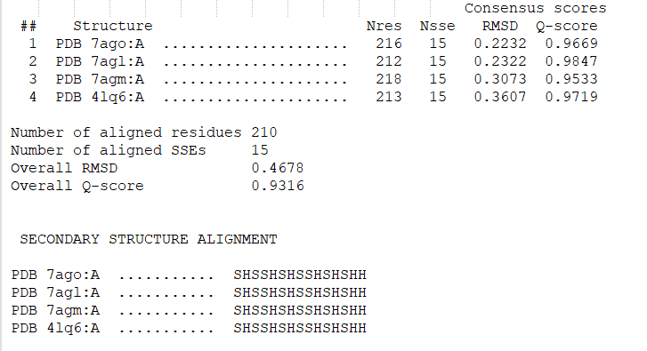
PDBeFOLD Multiple Alignments
Repeated in Mycobacteria genus
Notes:
Output 4: Mycobacteria genus only (7 structures, same settings as output 1)
RMSD 0.4795, Q-score 0.7921 (very well aligned on the surface, however sequence identity for the final four is the same, therefore questioning how good this is)
Removed the three duplicates (retained 4LQ6:A) and re-ran with 4 non-redundant structures, and new RMSD was 0.4678, Q-score 0.9316 (actually improved the alignment!)
All secondary structures conserved even if sequence wasn’t
But on the whole sequence was conserved as well as structure.

Slide 8
Identification of other structures
Initial BLASTp search was just on E.coli AmiC (4BIN)
Repeated search (restricted to PDB) for the other structures – no new amidase structures identified with significant similarity to those identified already
5J72: Clostridium difficile amidase, similarity to 4 cell-wall/S-layer proteins
1XOV Listeria monocytogenes bacteriophage, had 7 additional structures found with similarity
No other new structures identified in PDB sequence similarity search
Simple search for AmiA, AmiB, and AmiC in the PDB found 4 additional structures all from late 1990s in Pseudomonas aeruginosa, identified AmiC as having periplasmic binding domain and regulating the Amidase operon, as well as a few more potential NAMLAA in gam negative species by searching AmiA. Additional 4 structures found.
Notes:
5J72: Clostridium difficile amidase, had 4 structures with higher similarity than to other amidases, all either S-layer proteins or cell-wall binding proteins (probably due to N-terminal domain), so we can infer that this structure localises to the cell wall of the bacteria.
1XOV bacteriophage amidase had 7 additional structures found with similarity in BLASTp. A variety, but includes alanine racemase in S. aureus (which is involved in cell wall biosynthesis), and one other Listeria endolysin.
No other new structures identified in PDB sequence similarity search
Simple search for AmiA, AmiB, and AmiC in the PDB found 3 additional structures all from late 1990s in Pseudomonas aeruginosa, identified AmiC as having periplasmic binding domain and regulating the Amidase operon, as well as a few more potential NAMLAA in gam negative species by searching AmiA. Additional 4 structures found.

Slide 9
Identification of other structures
PDBeFOLD pairwise alignments
Search parameters: Against Whole PDB archive, lowest acceptable match of secondary structure alignment of 50%
Q-score threshold for ‘adequate similarity’: Above 0.3
P-score threshold: above 3, matches below this statistically insignificant
Results (Summary):
Most structures had thousands of matches with structures, however only around 20-30 significant matches each.
4BIN only had one other match with these parameters (3NE8)
5J72 had no matches at 50% SSE, therefore repeated at 40%. No matches that weren’t the same model with a P value above 3.
1XOV only had one other match (another Listeria bacteriophage endolysin) above threshold.
The four ‘AmiA’ structures only had significant alignment with each other, identified one other ‘AmiA’ structure.
Total structure list after searching: 24 (the original 19 plus 5 additional un-annotated family structures)
Notes:
Search parameters: Against Whole PDB archive, lowest acceptable match of secondary structure alignment of 50% (with other close matches shown if none within limits), matching individuals chains and connectivity (unique and best matches only), precision Normal. Chose lower sequence similarity than default due to observed low sequence identity in the original 19 identified sequences with NAMLAA predicted function.
Where similarity is identified in multiple chains for the same structure, have ensured all scores are recorded.
Added results with a Q-score above 0.3 to document (based on MSA of the original 19 structures where all Q-scores were above 0.3 threshold)
If alignment was to another chain in the same model, Q-score and RMSD was not recorded.
Structure not included if P-score was below 3, as match is considered statistically insignificant (per PDBeFOLD stats advice)
Of note: 4BIN only had one other match with these parameters (3NE8)
Of note: 5J72 had no matches at 50% SSE, therefore repeated at 40%. No matches that weren’t the same model with a P value above 3.
Of note: only 27 matches with 1XOV, and only one of these (a cell wall binding endolysin domain in bacteriophage) was above threshold for P and Q scores.
The four ‘AmiA’ structures only had significant alignment with each other, identified one other ‘AmiA’ structure (unannotated in the PDB)
Total structure list after searching: 24 (the original 19 plus 5 additional un-annotated family structures, all gram negative, possibly AmiA and which don’t align with any significance with any of the original 19).

Slide 10
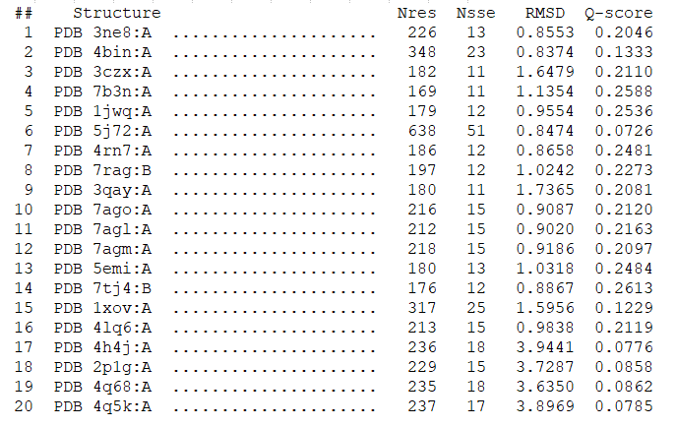
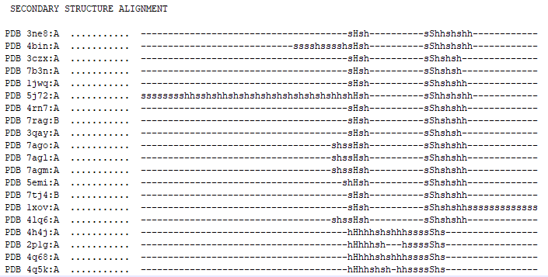
Identification of other structures
Repeated PDBeFOLD including the 4 ‘AmiA’ analogs identified
Consensus RMSD: 2.858, Consensus Q-score: 0.01216
Notes:
Re-did the PDEeFOLD analysis for the new structures (including the 3 ‘AmiA’ analogs)
RMSD much higher for the new 4 compared to all the other structures previously searched
Overall RMSD: 2.858, Overall Q-score: 0.01216 (worse than without the new structures)
Difference in secondary structures for the new four as well
Therefore is this evidence for the other four self-described as AmiA to be a different enzyme to the others with a different function?
These four seem to be separate from the others in BLASTp searches, all the other amidase_3 appeared in similarity searches of all the others (except for the bacteriophage, 1XOV, and the Neisseria meningitidis one, 3CZX (which had no similarity matches).
All the others (except the bacteriophage) have been reported with Zinc ion ligands, but the four AmiA have not (reported with sodium ion instead).

Slide 11
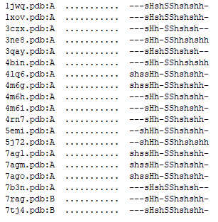
Cropped Structures
New tactic: Crop structures to just Amidase_3 domain (remove N- and C-terminal domains) per PDB annotations
Multiple comparison of these structures using PBBeFOLD
With the 5 ‘AmiA’: RMSD 3.0837, Q-score 0.0212
Without the 5 ‘AmiA’: RMSD 1.655, Q-score 0.3561
Previous without cropping: RMSD=1.5525, Q-score of 0.1255
US-Align
Used US-Align to confirm results from PDBeFOLD
Also removed extraneous chains (used the best match chains from original BLASTp search)
TM score around 0.3 for the potential AmiA orthologs, but around 0.7 for all the others.
Notes:
Repeated PDBeFOLD for the 24 (cropped to domains # cropping all except the amidase domain
# 1jwq is just the catalytic domain, no cropping needed
Uploaded edited structures as a tarball
Repeated with just the 19 as the 24 produced an RMSD above 3 and Q-score of around 0.2 (these 5 possible AmiA seemed to throw off the alignment)
Overal RMSD: 1.655, Overall Q-score 0.3561
Notably very well conserved secondary structure alignment
Ran US-Align to confirm the results (an update to TM-Align which allows multiple alignment for structures not just pairwise, although couldn’t get the PyMol plugin to work so visualiser not available for results) (also have pair-wise alignments for each structure vs each structure)

Slide 12
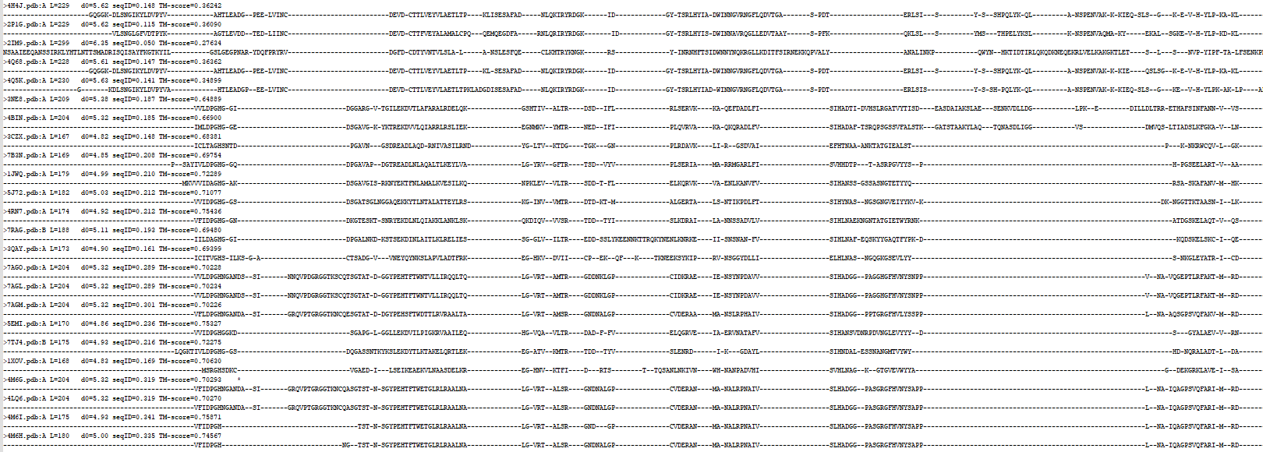
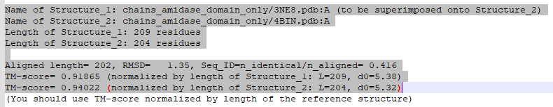
Notes:
4BIN and 3NE8 still have what looks like an additional helix (the proposed mobile helix region) – these were the structures from E. coli and Bartonella henselae, both gram negative. However other gram negative (the Thermus parvatiensis AmiP 7B3N and the 3CZX from Neisseria meningitidis) don’t have this additional helix in the alignment. To look into proposed functions of all four, maybe only 3NE8 and 4BIN are AmiC, this might be the identifier for function?
Did also run US-Align with the uncropped structures, and found 7RAG (an amidase in complex with lipoprotein from Clostridium difficile) had a very low TM score (,0.01), but did align with others on BLASTp similarity search on PDB structures, and PDBeFOLD aligned it with several other NAMLAAs.
Bacteriophage and Staph. A LytH also had poor TM scores (around the 2.4 mark). Very likely due to the longer N-terminal domains and the 7RAG lipoprotein chain in the PDB structure.

Slide 13
Findings from structure alignments
4BIN and 3NE8 align very well
PDBeFOLD pairwise alignment only has significant alignment for 4BIN with3NE8
TM-Align score very high for these two
The only structures with an additional alpha helix structure in both PDBeFOLD and US-Align alignments
Other groups starting to form
Higher sequence and structure identity (low RMSD) for Mycobacteria/Mycobacteriodes
Bacteriophages with long N-terminal domains
A potential group of AmiA amidases which align well to each other but not the other NAMLA amidase 3 families.
Notes:
Bacteriophage amidases coming with a long N-terminal domain (5J72), to bind to cell wall? 4BIN also has an AMIN domain which potentially binds peptidoglycan (cell wall) as well, with proposed unknown binding region.

Slide 14
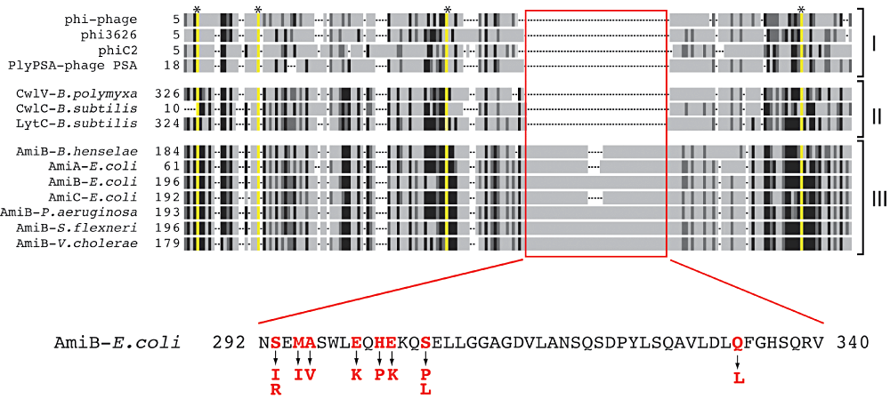
Literature for these structures
There are 3 reported roles for NAMLAA depending on the species:
Group A: Autolytic cell-cycle (proposed this is specific to gram negative bacteria?)
Group B: Autolytic sporulating (eg Clostridium difficile, role is to kill parent cell)
Group C: Endolytic (role also to kill parent cell upon infection)
Yang,D.C. et al. (2012) A conformational switch controls cell wall-remodelling enzymes required for bacterial cell division. Molecular Microbiology, 85, 768–781.
Notes:
3NE8 paper posed 3 functions for LytC-type amidases (NAMLAA): lytic from bacteriophages, lytic from sporulating bacteria, and cell separation amidases (which are the ones I’m after!) And that those with cell separation function have the self-regulating helix, as why would an amidase whose function is to lyse the cell wall to death want to be regulated?

Slide 15
Existing domain classification tools
Issue being that domain annotation tools don’t recognise the differences between these three functional roles
UniProt/SwissProt: Draws in information from other tools or databases
InterPro: Incorporates the models from 13 member databases including SMART
SMART: Multiple Sequence Alignment and HMMer (with similarity score threshold to cluster protein families)
ECOD: F-class classification using Pfam mapped families and HHsearch clusters
CDD/SPARCLE: RPS-BLAST and position-specific scoring matrices
GO Annotations: Manually curated files (InterPro2GO, Keyword2GO)
PANTHER: N/A for NAMLAA
PROSITE: N/A for NAMLAA
Notes:
UniProt/SwissProt: Provides assertion method (manual vs automatic), but draws in information from other tools or databases (does not appear to run the tools themselves in domain identification).
Includes both experimentally derived evidence and computational evidence. For amidase_3 (amiC), had just automatic annotation from SMART ‘inferred from signature match’.
InterPro: Lists as ‘IPR002508’.
Incorporates the models from 13 member databases including SMART, adds the GO annotations on top of that
I think matches the different signatures and profiles produced from the 13 databases and combines them into a consensus where they are different to assign them a family.
SMART: Lists as ‘Ami_3’ (SM00646), reported in UniProt, Pfam, etc. Family includes phages as well as bacteria (therefore does not distinguish between specific function, although acknowledges phage endolytic and autolytic functional difference in-text – endolytic not having signal peptide and autopytlic having a C- or N-terminal cell wall binding domain).
Combines Uniprot, stable ensembl proteomes. Contains 137mill+ proteins from 537,000 species+.
1998 paper: ‘Manually curated hidden Markov models’
Uses manual curation to annotate domains (using multiple sequence alignment and selecting a cut-off threshold for similarity to cluster each domain manually).
Gapped multiple sequence alignments (encompassing secondary structures of known tertiary structures), found candidate homologues using HMMer and two other iterative tools (MoST and WiseTools) which were statistically significant in their alignments but also includes some homologues experimentally shown to operate in the same biological context.
True positive/true negatives manually decided upon for each domain by assigning am SWise similarity score (scoring algorithm) threshold based on ‘published homology arguments’
Protein profiles generated from the alignments, then constructed hidden Markov models (assuming to identify patterns in the domains which can be applied to match with new sequences being entered?)
ECOD (domain ID e3ne8A1 for Amidase 3, using the protein family Amidase 3). F-class classification still contains both endolysins and autolysins.
Can be automatically assigned (was automatic for 3NE8).
F-group = domains with significant sequence similarity, mostly mapped Pfam families and some HHsearch clusters.
Also provides automatic groupings based on architecture of the structure, possible homologs based on high sequence/structure scores, functional similarity, features, topology.
Only uses structures derived in the PDB, emphasises distant evolutionary relationships.
Has a classification pipeline that gets more and more specific (starting with the SCOP superfamilies and pairing protein structures based on low lidentity, around 40%), but for F-class, uses hidden markov modelling like SMART does (HMMER and HHsearch-based clustering)
CDD/SPARCLE: By the NCBI, architecture ID for NAMLA is 11436722
Searches based on protein sequence, uses RPS-BLAST to produce position-specific scoring matrices against a protein query (these are pre-calculated against the conserved domain database)
Manually curated at least for the NAMLA architecture
Does not distinguish between sporulating Clostridium difficile and the normal function cell cycle autolytic bacteria.
GO Annotations
A mix of manual annotations and computational predictions for gene products, indicated by evidence code.
Manual curation based on papers (functional evidence).
99% are computational annotations: project annotations from one species to another based on orthology (like the EggNOG database), prediction based on curated rules, prediction based on sequence features, mapping of concepts to GO terms(?)
Annotations from: InterPro2GO, UniProt Keywords2GO, UniProt Subcellular Location2GO, EC2GO, UniRule2GO, Ensembl and Ensembl Genomes, UniPathway2GO, Gene Ontology Consortium, RNACentral
InterPro2GO: Manually curated file by looking between proteins and InterPro and selecting an appropriate GO term for all proteins in the family (using stats in keywords, comments, annotation conservation). 90-100% accurate.
Keyword2GO: Manually curated and based on literature/sequence analysis checks (from TrEMBL entries on keywords in nucleotide sequence, and using Spearmint decision tree program and RuleBase rules algorithm). 91-98% accurate.
PANTHER
N/A for NAMLA, no organism matches in their database, but uses protein placement in a phylogenetic tree to inform classification of sequences (TreeGrafter)
PROSITE (N/A didn’t have Amidase 3 as a domain, although describes it under the LytM entry)

Slide 16
Next Steps?
Question is: Is it possible to identify the Group A’s out of the sequences or structures tagged as being NAMLAA or having cell division function?
Speculated that only gram-negative bacteria have this secondary mobile helix
Could I make a tool that recognises this helix in an alignment and pulls out the Group A amidase 3 proteins?
From there, identify patterns in these Group A proteins, and try to detect other possible Group A NAMLAA from sequences?
Could use a model (k-means as suggested last meeting) to find those patterns, train/test on AlphaFold models since only two in the PDB ‘truthset’ for Group A?
Notes:
Sequences: Could search for similarity in sequences in non-redundant NCBI dataset. (blastp)
Clustering database search prevent having many hits from the same cluster (uses a representative sequence from each cluster, one cluster = sequences at 90% identity and 90% sequence length).
Expanded amidase_3 excel list of 177 proteins, classify these into the three groups?
Using alignment of the sequences in HMMsearch (found 314 significant hits in reference proteome database)and eggnog database to form phylogeny for these proteins? When did the three classes diverge?
(there are ‘unrecognized’ proteins I the PDB which came up in one of the PDBeFOLD pairwise alignments, can we confirm if they are NAMLA and if they are Group A?)

Slide 17
Update
23/06/2023

Slide 18
Plan for past week
Annotated Bibliography (to complete)
Hypothesis: Helix is only in gram negative bacteria for the cell wall division process, as helix self regulates this type of amidase. This type of amidase is not present in gram positive and therefore gram positive amidase sequences will lack this helix.
Q1: Is this in other gram negative bacteria?
Q2: Is this in gram positive bacteria?
If evidence gained in these sequences, then could use the helix as a conserved feature for better categorising amidases? (autolytic vs endolytic vs sporulating function)
Taxonomic map of domain occurrence
Number of amidase genes in each genome (looking at WGS)
Are there any other conserved features between bacterial sequences looking at amidases?
Get a taxonomy that can be sub-divided, generate taxonomic ID for each bacteria (need to research how to do this)
Clustering analyses
K-means clustering of RMSD and Q-score in the structures identified (for visual representation of clustering in structure alignments)

Slide 19
Sequence Search
Hypothesis: Helix is only in gram negative bacteria for the cell wall division process, as helix self regulates this type of amidase. This type of amidase is not present in gram positive and therefore gram positive amidase sequences will lack this helix.
Used RefSeq whole genomes (WGS) rather than non-redundant sequences in NCBI
Searched using cropped domains
BLASTp and phmmer to search using the 3NE8 and 4BIN sequences (the two gram negatives with hypothesised self-regulating helix)
Search 1: Using cropped sequence from 3NE8 (Bartonella henselae)
Search 2: Using cropped sequence from 4BIN (Escherichia coli)
Notes:
The other gram negative structure identified was in sporulating bacteria (n. meningitidis) and weren’t hypothesized to have the helix(? Is that accurate?)

Slide 20
3NE8 Protein Sequence
BLASTp: In NCBI RefSeq Select
Limited to top 5000 results
phmmer: In Reference Proteomes (Ensembl Genomes had isolates from similar/same species)
Reference proteomes from EMBL-EBI, non-redundant proteome sets from UniProtKB, Ensembl, Ensembl Genomes (79 chosen species)
11855 significant results
Phmmer REST API output gives alignment (only top n alignments, around 50?) but not sequence ID/accessions, species, or individual sequences. Also doesn’t give all 11,000 sequence alignments with query sequence (scrap, use NCBI BlastP only?). Too many results for clean download from web client.

Slide 21
4BIN Protein Sequence
BLASTp: In NCBI RefSeq Select
Limited to top 5000 results
phmmer: In Reference Proteomes
11531 significant results (however sequences again not accessible in full)
Notes:
Could use isolate data from InterPro if need another source for sequences, however this is not non-redundant
For bullding taxonomy later on: EggNOG database for more distant orthologs?

Slide 22
Amidase_3 sequence alignments
Using available identified sequences from 3NE8 and 4BIN (n=10,000)
Removing identical sequences (n = 7161)
Alignment of all sequences:
webPRANK for ‘phylogeny aware multiple sequence alignment’ – Max. 500 sequences (no source code available)
ClustalOmega (using precompiled binary on local machine)
Kalign3 (allows for large-scale multiple sequence alignment, benchmarked against ClustalOmega / Muscle)

Slide 23
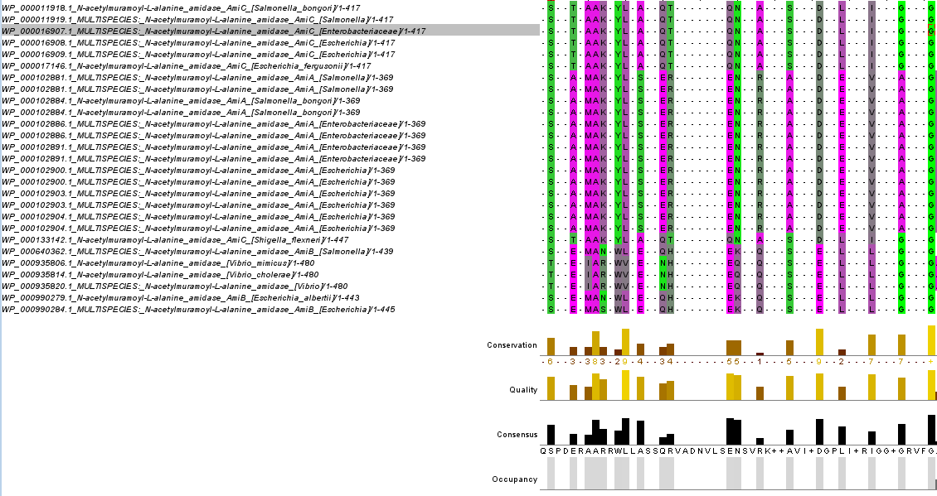
Amidase_3 sequence alignments
Identification of conserved regions (predicted secondary structures)
Notes:
Jalview
High occupancy region here (this matches the proposed gram-negative regulatory helix in the highlighted sequence
Answers question 1: Yes, this is highly conserved in other gram negative bacteria. But is it in gram positive bacteria?

Slide 24
Gram positive sequences
Repeated BLASTp search with the other amidase_3 sequences in gram positive
5J72, 4RN7, 7RAG, 7AGL, 7AGM, 5EMI, 7TJ4
Got the top 5000 hits for each (45,000 sequences)
Removed duplicate protein IDs (same NCBI reference sequence ID) to get non-redundant species set (n = 34,740)
Alignment of all sequences using kalign
Examination using Jalview
Is the helix still conserved across all sequences, even gram positive?
Notes:
5J72, 4RN7, 7RAG, 7AGL, 7AGM, 5EMI, 7TJ4

Slide 25
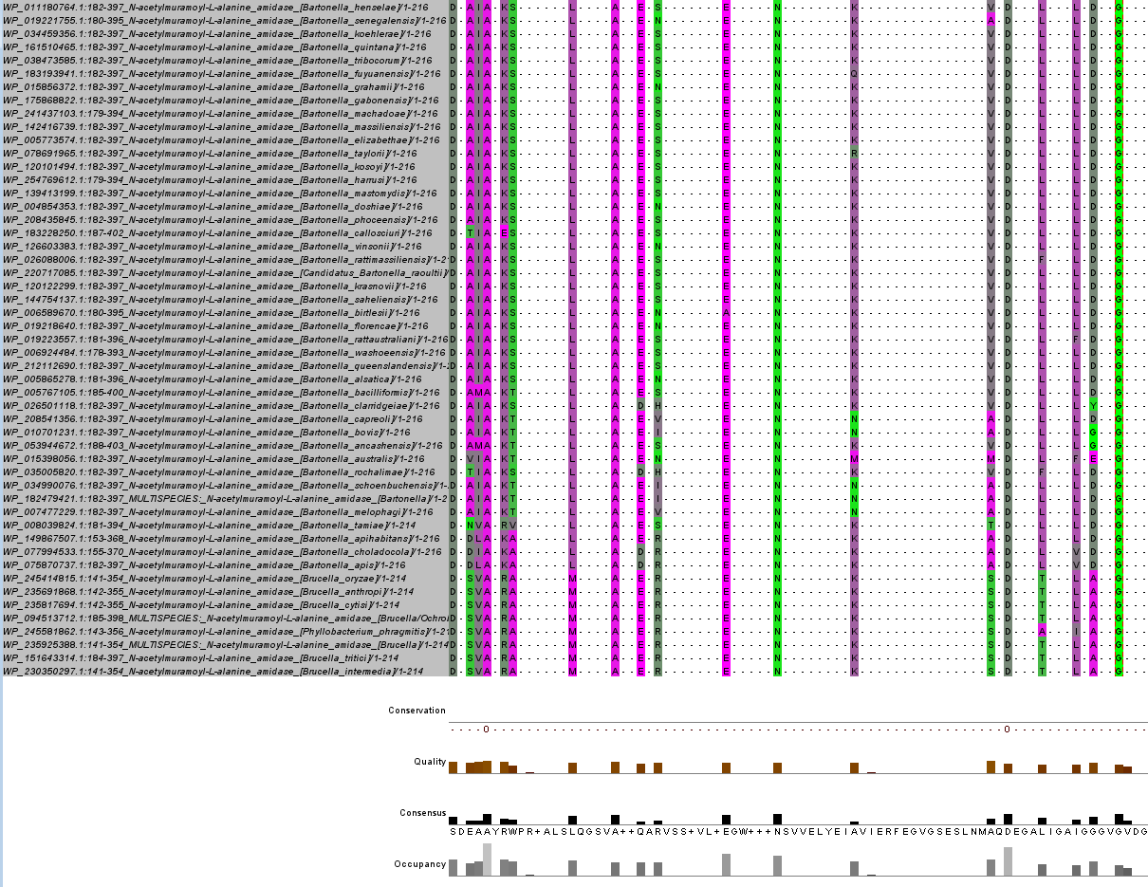
Notes:
Gram negative

Slide 26
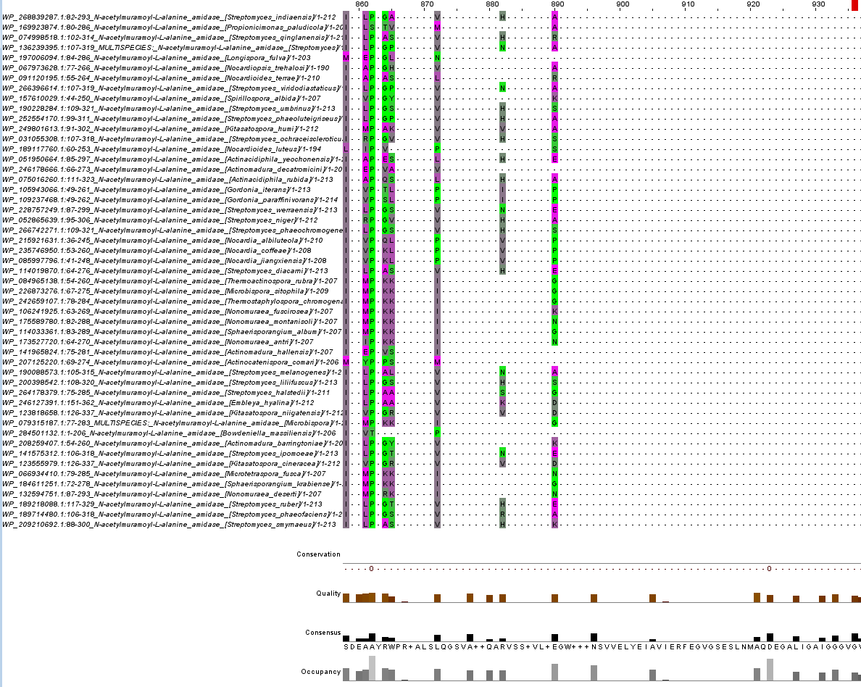
Notes:
Gram positive, same region of alignment

Slide 27
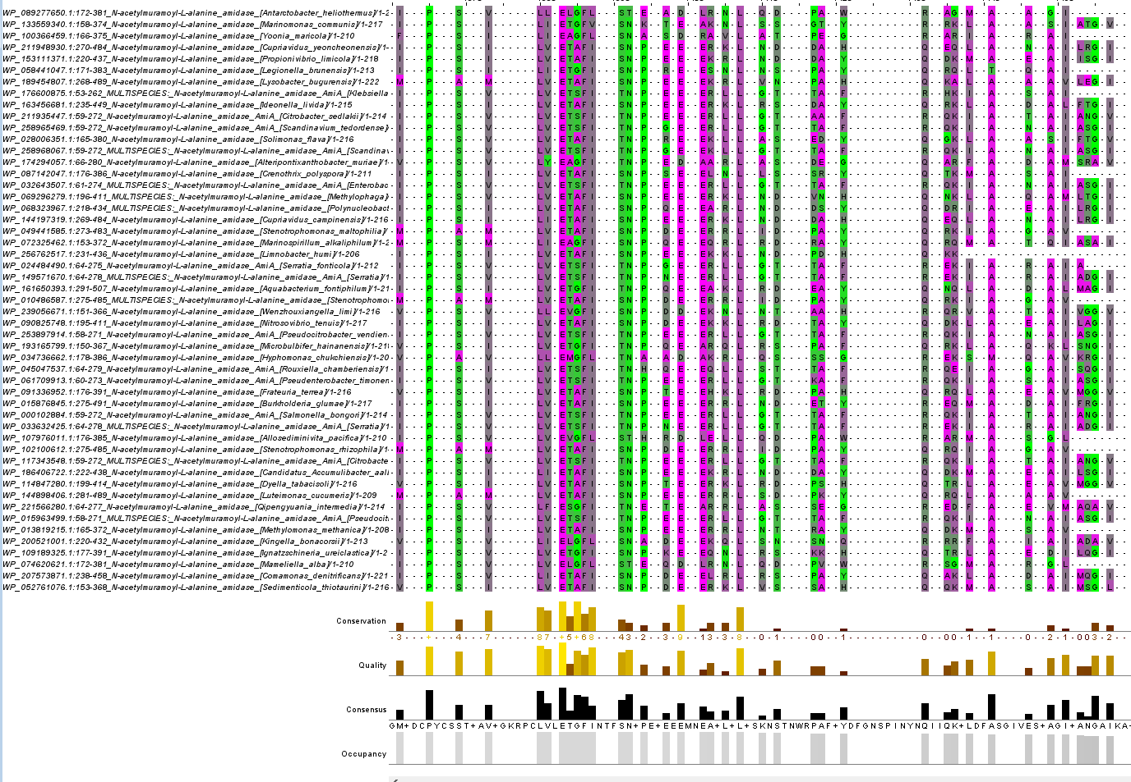
Notes:
High conservation of sequence in gram negatives, but overall poor consistency, and missing residues in gram positives that are highly conserved in gram negatives (but can I quantify?)
Overlay centre: Comparison region which is highly occupied and consistent across gram negative and gram positive sequences

Slide 28
Update
21/07/2023

Slide 29
Identifying Taxa
Hypothesis: Helix is only in gram negative bacteria for the cell wall division process, as helix self regulates this type of amidase. This type of amidase is not present in gram positive and therefore gram positive amidase sequences will lack this helix.
Q1: Is this in other gram negative bacteria?
Q2: Is this in gram positive bacteria?
If evidence gained in these sequences, then could use the helix as a conserved feature for better categorising amidases? (autolytic vs endolytic vs sporulating function)
Taxonomic map of domain occurrence
Number of amidase genes in each genome (looking at WGS)
Are there any other conserved features between bacterial sequences looking at amidases?
Get a taxonomy that can be sub-divided, generate taxonomic ID for each bacteria

Slide 30
Generating Tax ID
Multi-step API call:
NCBI Datasets v2 REST API (allows retrieval of taxon information from ‘taxonomy’ datasets)
Retrieved: Tax ID
Taxallnomy (allows lookup of tax ID from NCBI to get higher order classification info)
Retrieved: Family for each species

Slide 31
Dataset cleaning (step 1)
Starting: N = 34,740
383 sequences could not be suitably annotated with NCBI API, removed these (N = 34361)
Sequence name often something like ‘multi-family’
Non-bacterial sequences
Pseudococcidae x4 (mealybug endosymbiotes? Unconfirmed)
Corticovirus and Keylargovirus (x16, bacteriophages, left in as these are relevant)
Thermococcaceae (thermophilic archea)
Anything called as a partial sequence removed (new N = 34,007)
34,007 sequences re-aligned with kalign

Slide 32
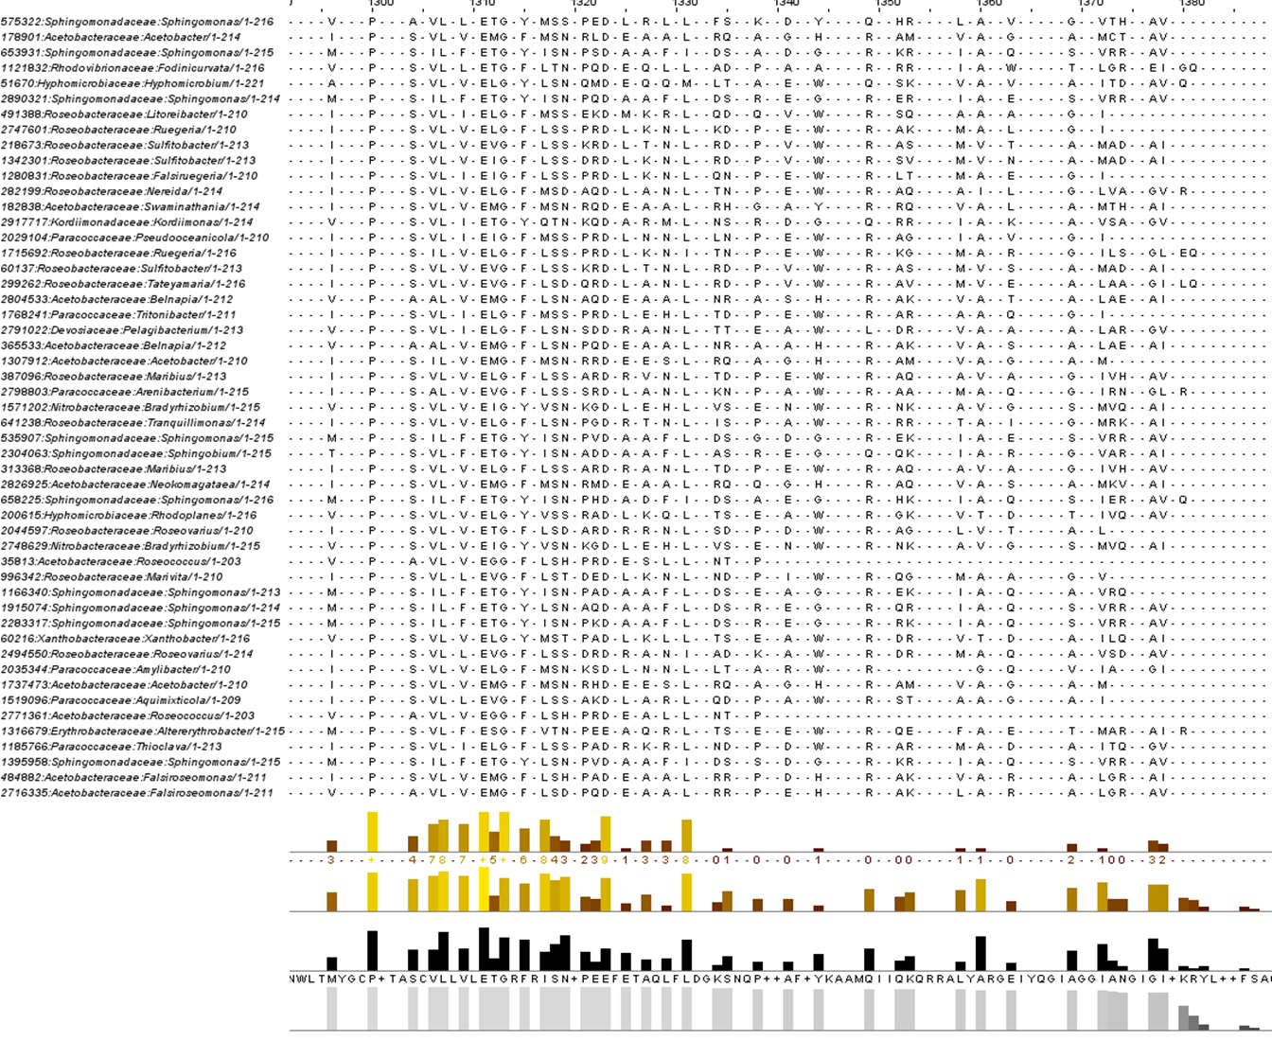
Notes:
(still not happy with this although it is better than before – want to automatically remove sequences causing gaps in these high consensus/identity regions as its double-digits in 34,000+ sequences, need to implement later)

Slide 33
Tag sequences with identity in the helix 5 region
Based on predicted helix region from 3NE8 and 4BIN (PDBeFOLD), the sequence pattern in that sequence is DAIAKSLAESENKVDLLDG.....DILLDLTRRET
Treat these as helical positions, anything that has a residue in 90% of those same positions is high confirmation, >70% as medium confirmation, >50% as low confirmation
In current alignment: 754, 757, 760, 767, 769, 771, 775, 777, 780, 789, 791, 792, 799, 803, 806, 810, 815, 821, 823, 897, 900, 901, 902, 903, 905, 907, 908, 911, 913, 917
90%: 10265 sequences, 70%: 11053, 50%: 11152

Slide 34
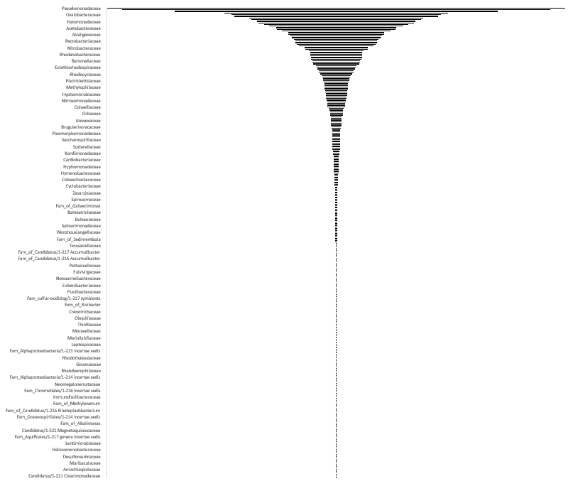
Top 20 families (90% positional match)
Pseudomonadaceae | 814
Enterobacteriaceae | 760
Burkholderiaceae | 573
Paracoccaceae | 399
Oxalobacteraceae | 372
Xanthomonadaceae | 362
Roseobacteraceae | 309
Yersiniaceae | 302
Halomonadaceae | 281
Erwiniaceae | 277
Sphingomonadaceae | 256
Morganellaceae | 240
Acetobacteraceae | 214
Comamonadaceae | 212
Vibrionaceae | 195
Legionellaceae | 172
Alcaligenaceae | 171
Rhizobiaceae | 164
Azospirillaceae | 158
Neisseriaceae | 150
Notes:
Families above 30 count in the 90% dataset (LEFT: distribution, RIGHT: top 20 families), but not really a specific bacterial family identified
286 unique families

Slide 35
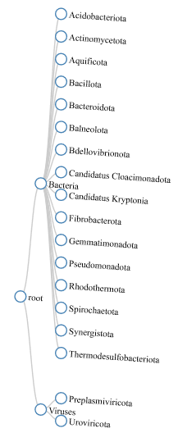
Negative (1 species, thermophile)
Positive (1 species: Kineosporia corallincola)
Negative (thermophiles)
Positive (Paenibacillus tepidiphilus,
confirmed stained positive and a thermophile)
Negative
Negative (extremophiles, saline/marine conditions)
Negative (Micavibrio aeruginosavorus – predatory bacteria
? (Candidatus cloacimonas – candidate, carbon fixing bacteria?)
? (extreme thermophiles, candidates – 3 species)
? (highly haloalkiniphilic, only one species Chitinivibrio alkaliphilus)
Negative (E.coli)
Negative (E.coli)
Negative (thermophiles)
Negative
Negative
Negative (Desulfovibrionales and Syntrophaceae)
Two bacteriophage-containing phyla
Notes:
Breakdown by phylum: 90 percent identity in the proposed mobile helix region
# 90% group contains 15 bacteriophage sequences and 4 gram positive bacterial sequences.
# no mycobacterium
Unknown = candidatus species (unclear of lineage, proposed organism)
LPSN very helpful in finding information about wall structure/staining results
Reviewed output of AMR and assigned gram-status where there was a publication backing it up (most were newly reported species, 2021-2023). AMR not good at classifying gram positives in this set, therefore based on phylogeny chart have swapped to gram negative where it mis-assigned the species in the search (ie mo_fullname and mo_family was not the same as the NCBI assignment).

Slide 36
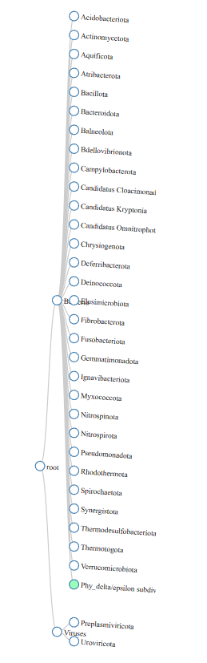
70%+
Negative
family | count
Pseudomonadaceae | 814
Enterobacteriaceae | 762
Burkholderiaceae | 573
Paracoccaceae | 399
Oxalobacteraceae | 372
Xanthomonadaceae | 362
Roseobacteraceae | 309
Yersiniaceae | 302
Halomonadaceae | 281
Erwiniaceae | 277
Sphingomonadaceae | 267
Morganellaceae | 240
Acetobacteraceae | 214
Comamonadaceae | 212
Vibrionaceae | 195
Legionellaceae | 172
Alcaligenaceae | 171
Rhizobiaceae | 164
Azospirillaceae | 158
Neisseriaceae | 152
Negative
? (Candidatus archeovorus)
? (Desulfurispirillum indicum)
Negative
Mix (double-membraned but has gram positive stain – thermophile)
? (Elusimicrobium minutum)
Negative
Negative (Ignavibacterium album)
Negative
Negative
Negative
Negative
Negative
Notes:
11053 sequence and 379 unique families in 70%, majority of these single family species added.

Slide 37
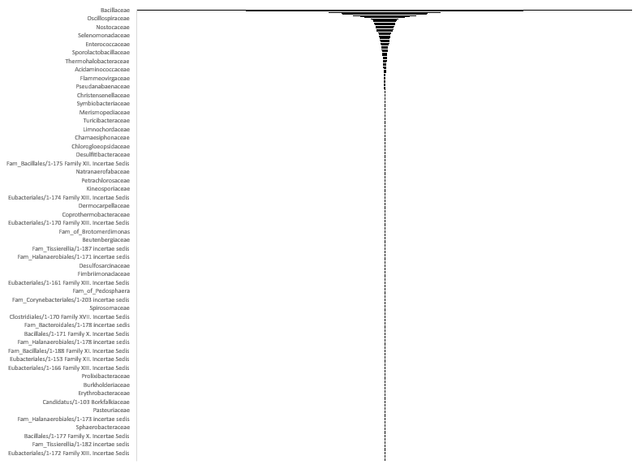
Low matches to region
Top 20 families (low positional match)
family | count
Bacillaceae | 5879
Paenibacillaceae | 3299
Clostridiaceae | 1337
Streptomycetaceae | 1025
Lactobacillaceae | 1005
Planococcaceae | 759
Mycobacteriaceae | 599
Lachnospiraceae | 495
Oscillospiraceae | 339
Peptostreptococcaceae | 295
Sporomusaceae | 287
Pseudonocardiaceae | 283
Thermoanaerobacteraceae | 262
Staphylococcaceae | 255
Flavobacteriaceae | 248
Peptococcaceae | 229
Nostocaceae | 225
Carnobacteriaceae | 216
Micromonosporaceae | 209
Nocardiaceae | 203
Notes:
424 unique families and 22852 sequences fall into this category, vast majority have 5 or fewer positional matches (19695) -

Slide 38
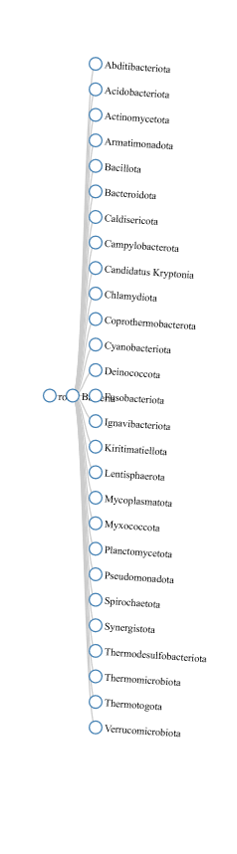
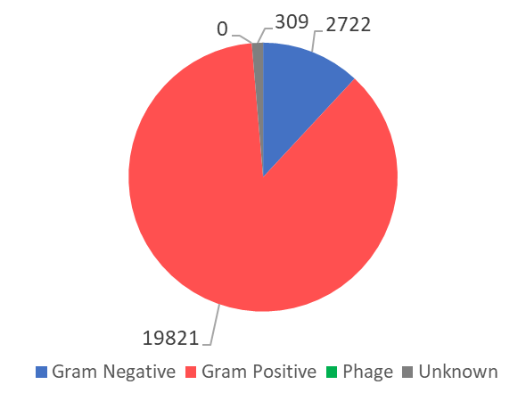
Negative
Negative
Positive
Negative
Positive (+ a few pseudo-negative)
Negative
Unknown (1 species: Caldisericum exile)
Negative
? (extreme thermophiles, candidates – 3 species)
Negative
Negative
Negative
Mix (double-membraned but has gram positive stain – thermophile)
Negative
Negative
Unknown
Negative
Negative BUT no cell wall, therefore putting in other/unknown
Negative
Negative BUT no peptidoglycan wall, therefore putting in other/unknown
Negative
Negative
Negative
Negative (Desulfovibrionales and Syntrophaceae)
Negative BUT defined by low peptidoglycan wall, therefore putting in other/unknown
Negative
Negative
Notes:
More of a mix here but still quite a large proportion of gram negative – still seems that having those insertions is an indicator of gram negative bacteria, possibly of that specific function – would need to do more extensive search into the bacteria listed here (might be sporulating bacteria?)

Slide 39
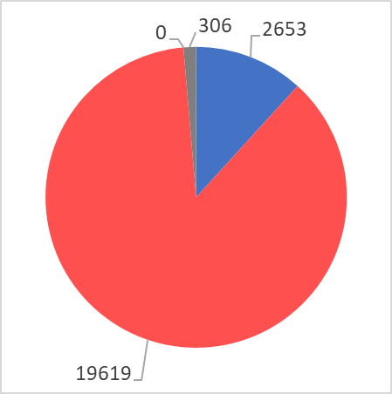
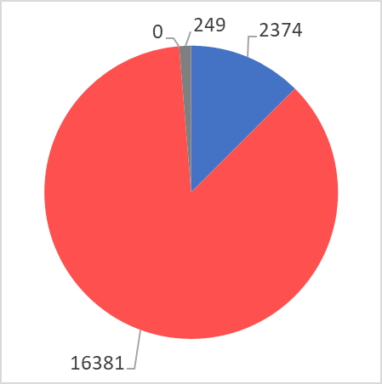
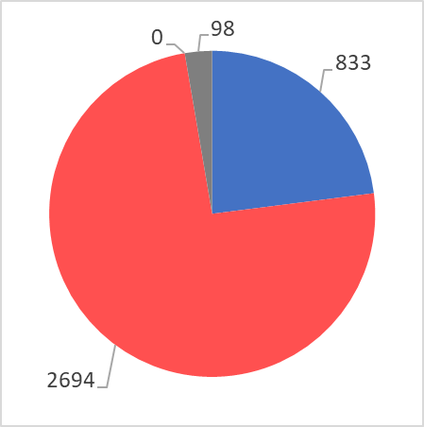
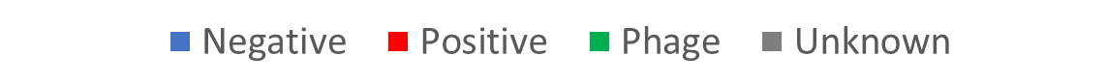
<15 <10 <5 0

Slide 40
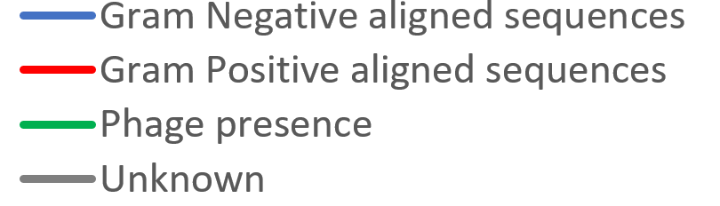
Raw Count
Percentage
Notes:
Pale lines in % graph: Less than 30 sequences (<0.1% of total)
0 insertion: check alignment?

Slide 41
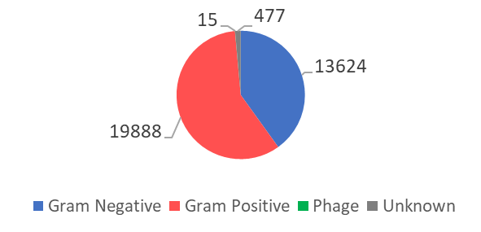
Next steps?
Any other regions to tag and examine?
eg low conservation across all sequences, or other 'dodgy' non-conserved regions?
there is another possible region near start, shorter region – which sequences is this present in?
Better cleaning approach for the MFA
Higher consensus in conserved regions of amidase enzyme needed
Better presentation of sequence alignment (dendrogram?)
PCA?
Notes:
Could also look into bacterial roles (ie sporulation, phage activity)?
Top left: Total dataset makeup of gram status
Logo (amino acids) for region to demonstrate conservation
MFA cleaning first
Count check for cols (distribution and see if any cut-offs I can find)
Co-occurrence of features? A way to identify combinations
Evolutionary first: - or +?
Pairwise alignments for multiple large sequence sets – sequence identity clustering? Hierarchical based clustering
Representative sequences for each phyla/family in a tree?

Slide 42
Update
01/09/2023

Slide 43
Phase 1: AmiC family identification and sequence analysis
Needed because: AmiC domain encompasses proteins with varying function (endolytic, sporulating, cell cycle) and isn’t on its own a distinctive classifier for differing function of amidase C in bacteria.
+MSA alignment outlier detection and removal step
Identified possible insertion region by aligning existing protein structures defined as bacterial AmiC
Aligned likely AmiC bacterial sequences through protein sequence database similarity searches
Illustrated insertion region appears more evolutionarily linked to ‘gram negative’ bacteria
After MSA cleaning: illustrated insertion region appears more evolutionarily linked to ‘gram negative’ bacteria
Clustering based on features from external tools (secondary structure clustering, residue hydrophobicity)
ML Modelling to identify boundaries of insertion or non-conserved regions? (Kmeans clustering?)
Therefore need to generate a ‘truthset’ of AmiC sequences and structures which can be used to further interrogate the differing functions of AmiC in bacteria, demonstrate the diversity of the AmiC protein, and generate new categories/clusters which are more functionally useful in distinguishing the protein between bacterial species.
Clinical utility; possible identification of targets for AmiC of differing function? Transient helix region?
After clustering: What features co-occur with the insertion region? What categories of sequence are there? Can we identify AmiC features?
Notes:
To do:
Sunday:
Clean MSA alignment
Re-run analyses for possible insertion region – same result or no?
Produce AA Logo for cleaned alignment to demonstrate conservation and possibly identify other features/regions
Find a way to cleanly present a phylogenetic tree or dendrogram for the full clean alignment (as figure for thesis)
Mon-Thurs
Define boundaries for sequence features (domains, predicted secondary structure features, insertion/deletion regions, highly conserved regions)
Secondary structure predictions for each sequence, tag sequences with this data
Domain identification
OR Could use a NN or HMM clustering model to identify the features for me? Would need more research
Tag all sequences with defined features
Cluster groups based on defined features
Identify links within each cluster (specific phyla? Taxa? Bacterial type eg gram status? Sporulating vs cell wall division vs endolytic?)
Answer question: Which features indicate function within cell wall division, and which do not?

Slide 44
Phase 2 – structural and functional analyses?
Structure prediction (AlphaFold?) for different clusters
Question 1: Examine structural differences for each cluster?
Cofactor docking and binding for different clusters
Question 2: Which cofactors are likely to bind?
Question 3: Where is cofactor likely to bind?
Question 4: Possible functional effect of binding? Transient region effect w/helix for insertion region?
Bacterial paralogues: typically to bind different cofactors, does this fit with the theory here? Do different clusters bind well to different things?
https://www.nature.com/articles/s41587-023-01773-0 FoldSeek - search for predicted structures of similarity?
New AlphaFold predictions for the different sequence clusters?

Slide 45
Cleaning MSA
EvalMSA
CIAlign
OD-seq (2015): Outlier detection based on gap-based metric (counts number of positions between two aligned sequences – pairwise examination – generates a distance matrix between the two sequences, and uses these to identify sequences with ‘unusually high’ average distances.
Designed for identifying outliers in large MSA
The higher the penalty for gaps, the fewer sequences will be accepted in the final alignment
Can input an MSA (phylip or fasta), tool then calculates a distance matrix and outliers predicted using bootstrapping (estimate confidence intervals) or looking at interquartile ranges.
Notes:
Started coding my own, but then didn’t want to re-invent the wheel, found a tool which already puts that theory into play.
Other tool: EvalMSA (didn’t work on my PC, source code did not compile and windows installer version was broken)
CIAlign: Not suitable, removes regions of low coverage such as insertions (would remove the key region in its processing pipeline!)

Slide 46
OD-seq – distance matrices options
To get distance matrix: Linear, Affine, Cumulative metrics (sequence binary: 0=residue, 1=gap)
Linear: Adds 1 pt if residue/gap is not the same between two sequences for every pair of sequences. Does not distinguish number or length of each gap.
Affine: Has a gap opening penalty (first gap after two aligned the same in the binary form scores 3pts, everything after that in the unaligned gap scores 1 pt). Shorter gaps score highly as a result (gap of 1 = 3pts, gap of 2 scores 4pts)
Cumulative: Linear with additional stipulation for gap extension (longer gaps scoring more the longer the gap is). Also not available in R Bioconductor package.
Affine would identify those regions which induce short gaps in otherwise conserved regions without penalising the long insertion region as Cumulative would. Went for Affine.
Notes:
IQR vs Bootstrapping:
IQR: Looks at distance vector for all sequences, distance vector values for Q1 and Q3 determined to generate an IQR, any sequence with distance measure >Q1 and <Q3 gets an outlier score of 0. Outliers are those outside the IQR and beyond a threshold value (Q1-distance / IQR). Works less well for alignments with many identical sequences (risk of generating an IQR of 0).
Bootstrapping: random selection (pseudo-replicates) of N sequences to compute mean/standard deviation of distance measures between the inspected sequence and the alignment at large. Outliers are those above a threshold for the distance measure – mean / st, dev.
Bootstrapping chosen due to risk of outlier inflation (alignment has several very similar sequences which don’t align well with the insertion region sequences, don’t want the algorithm to class all those as outliers because they are beyond and IQR based on sequences without the insertion region).
mBed mode: Uses a simpler model for matrix calculation that used random selection of pairwise comparison and not all sequence vs all sequences to reduce computational time.

Slide 47
Cleaned alignmens
Parameters decided: Affine distance matrix calculation, Bootstrapping (n=1000), mBed logarithmic distance matrix calculation.
Starting n = 34,008
Kalign repeated, MFA still with many gaps
Affine, 2 standard deviations (N = 33,312 (696 outliers identified))
Cumulative, 2 standard deviations (N = 33,386 (622 outliers))
Affine, 1 standard deviation (N: 28,584 (5,424 outliers)). Alignment STILL contains many gaps. Retained for further examination.
Notes:
Ran on output_cleaned_v3.fa
Command line prompt: od-seq –i [input] –r [file name for full results] –o [file name for outlier list] –c [file name for remaining sequences] –m [linear,affine, or cumulative]
od-seq -i output_cleaned_v3.fa -r cumulative_fullresults.txt -o cumulative_outliers -c cumulative_core -m cumulative
If still bad alignment, reduce st dev to 1 (add ‘-s 1’ to prompt) – did this for affine.

Slide 48
Notes:
Before OD-seq

Slide 49
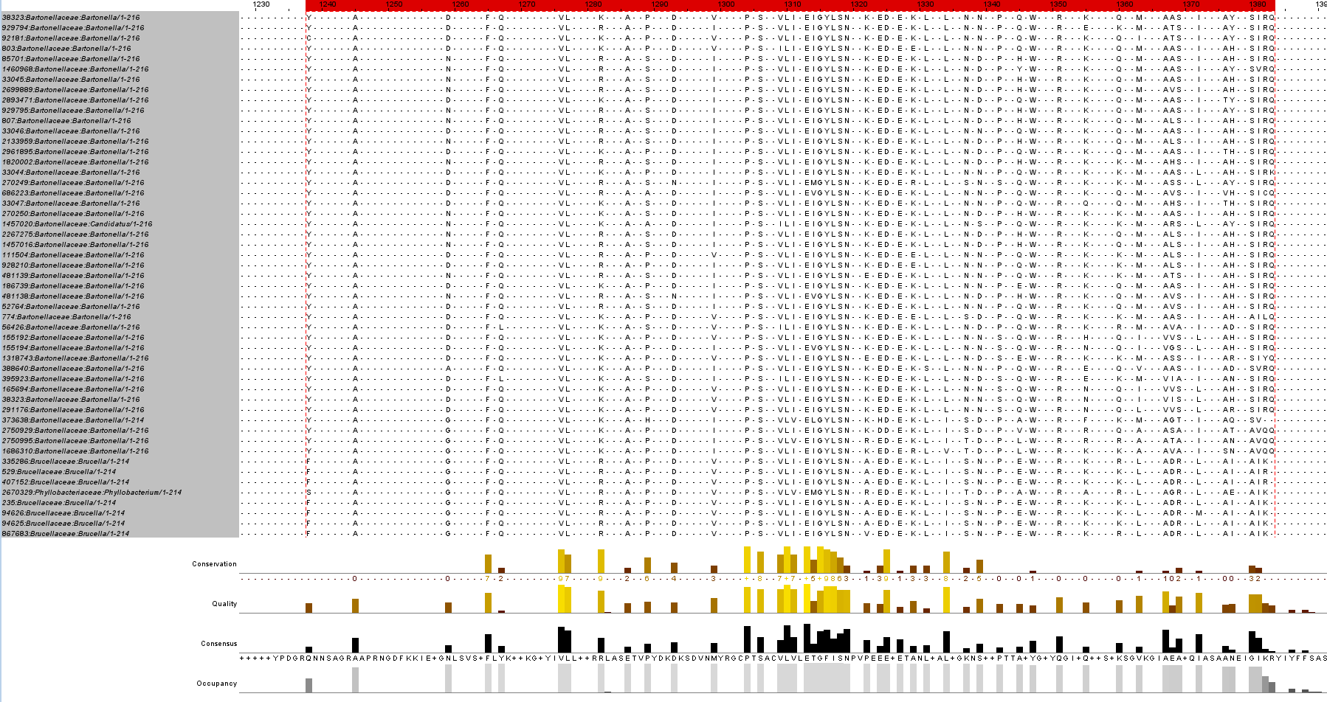
Notes:
After OD-seq

Slide 50
Cleaned Alignment – method 2
Using affine 1 st dev alignment from OD-seq output:
Own code to remove sequences inducing gaps that represent information from <0.1% of dataset
Goal: To hopefully retain an alignment which contains more valuable representation of conserved regions and possible insertions of importance (ie which are present in a larger proportion of the AmiC sequence dataset, and which removes insertions that might be induced either by error, by a specific isolate, or in one specific species).
Essentially; keep insertions which might be more important in determining feature clusters.
Return to review sequences with removed features later on?
Removed empty cols (gaps only) after these sequences removed
N=26,413 (removed 2171 sequences)
Repeated for gaps induced by <1% of dataset
N=20,217 (removed 8367 sequences)
Insertion region analysis then repeated.
Notes:
Many many gaps still within alignment, however these might be indicative of evolutionary changes for each species (insertions for certain species as the bacteria evolve). Average distance matrices for 1 st dev alignment show these proteins are closely related and that the alignment hasn’t got ‘outliers’, but given the number of insertion regions it is unlikely this set will generate an improved alignment.
To retain insertions which are likely to be valuable in clustering of features, gaps which are induced by <0.1% of sequences (28.6, or 29 sequences) are identified, and those sequences removed from the dataset.

Slide 51
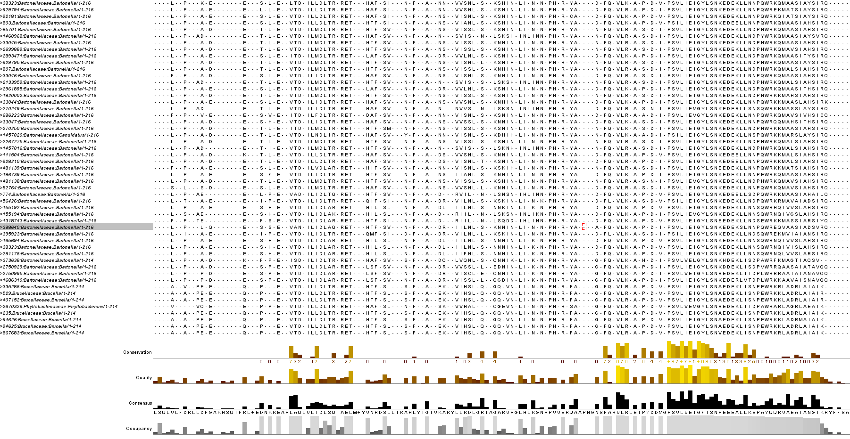
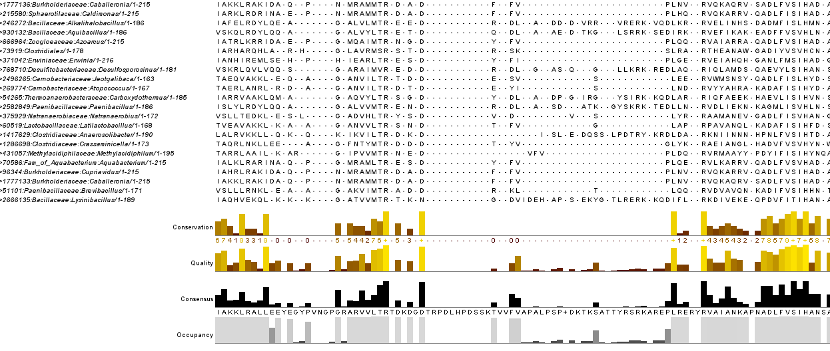
Notes:
0.1% (looking better!)
In picture: A possible second insertion region??

Slide 52
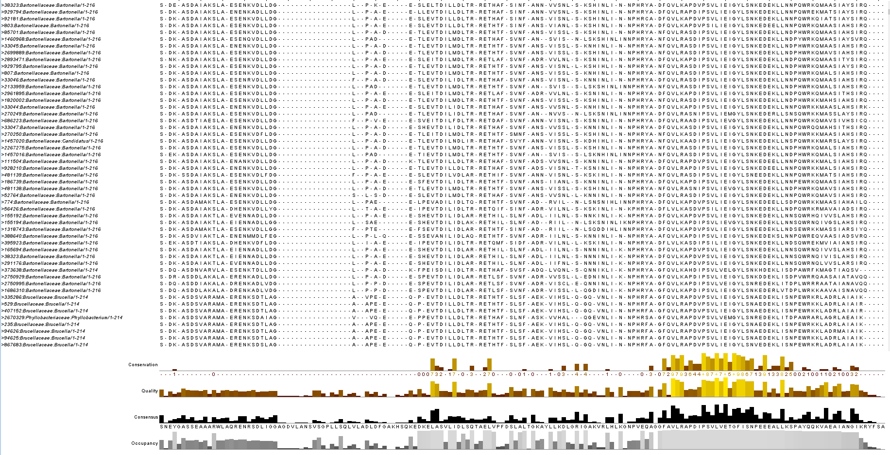
Notes:
1% (much much cleaner, can very easily see which regions are conserved and which contain possible insertion regions). Insertion region of interest highlighted. Alignment = 306 residues long.

Slide 53
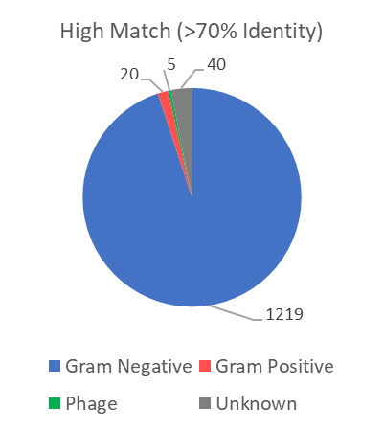
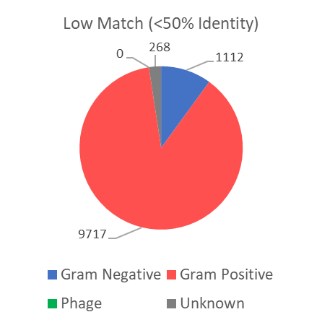
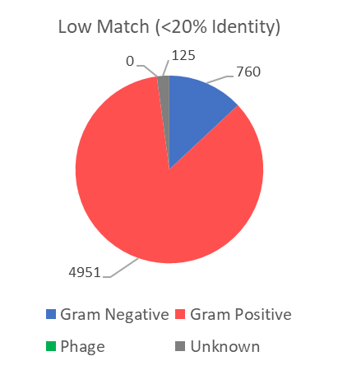
Predicted insertion region (based on secondary structure helix prediction of 4BIN and 3NE8 and occupancy of MSA in this
Region). Have used an expanded region based on reduced occupancy in/around that region, to prevent result becoming
biased on the two structures first examined. Looked in pos. 140-215 (75 positions).
Notes:
Insertion region re-analysis
Get a consensus sequence if this one is good
Also a logo
Also rerun the insertion region analysis

Slide 54
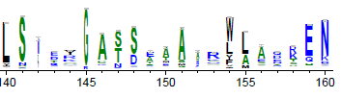
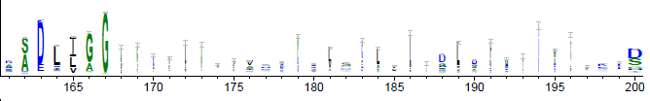
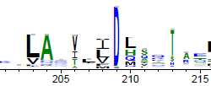
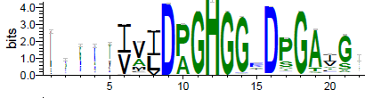
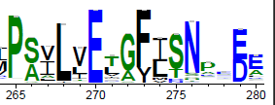
Logo for possible insertion region (140-215); two main areas identified. Hydrophobic = black, hydrophilic = blue, neutral = green
Next step: Annotate each sequence with additional features:
Secondary Structure Predictions (from an external tool)
Hydrophobic/Hydrophilic regions (external tool or code myself based on amino acids at each position)
Charged regions (external tool or code myself based on amino acids at each position)
Insertion regions (need to define boundaries for these)
Option A: Manual self-define boundaries – look at alignment, define insertion region by <X% occupancy (<20%?)
Option B: Use model (nearest neighbours? K-means?) to define insertion features and cluster sequences by region (need to split sequence set into test/training/validation sets, convert data into numeric – could be simple binary with 0 for a gap and 1 for a residue?)
Notes:
Produce AA Logo for cleaned alignment to demonstrate conservation and possibly identify other features/regions
Find a way to cleanly present a phylogenetic tree or dendrogram for the full clean alignment (as figure for thesis)
Tree based on protein sequences or whole bacterial sequences? Compare the two?
https://weblogo.threeplusone.com/create.cgi - weblogo
https://www.ncbi.nlm.nih.gov/pmc/articles/PMC8976100/ (?)
Define boundaries for sequence features
Secondary structure predictions for each sequence, tag sequences with this data
Hydrophobic regions
OR Could use a clustering model to identify the features for me? Would need more research - https://scikit-learn.org/stable/tutorial/machine_learning_map/index.html
Tag all sequences with defined features
Cluster groups based on defined features
Identify links within each cluster (specific phyla? Taxa? Bacterial type eg gram status? Sporulating vs cell wall division vs endolytic?)
Answer question: Which features indicate function within cell wall division, and which do not?

Slide 55
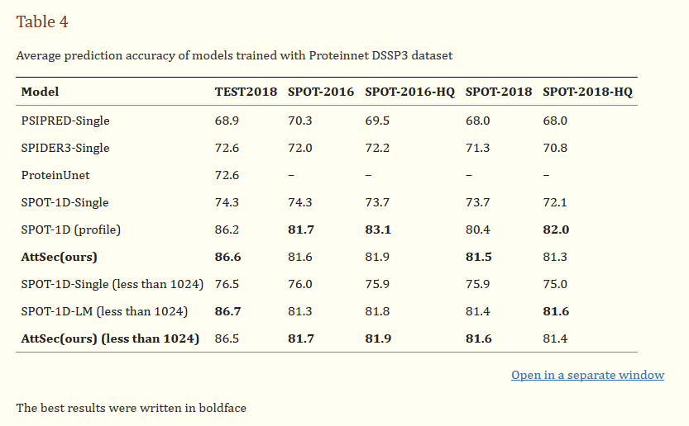
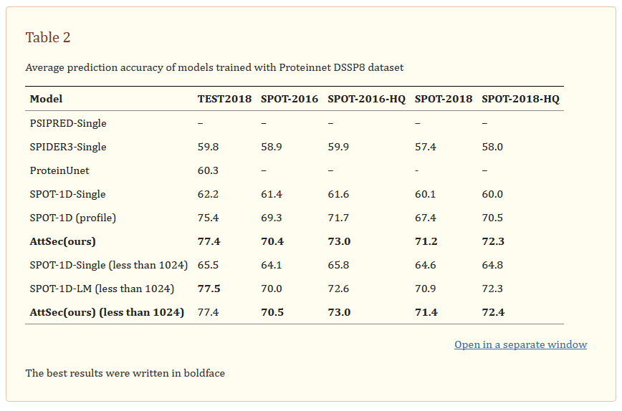
Secondary Structure Predictions
DSSP3 (used DSSP3 instead of DSSP8 for broader clustering later on – higher accuracy in models, and also didn’t want to assign two seqs to different clusters if the only difference was one had a 3-Helix and one had an alpha-Helix)
Have an MSA, could use a model which uses the MSA as evolutionary basis for prediction?
AttSec – 2023, Attention model, uses NLP instead of evolutionary modelling to predict structures for each amino acid (basically pairwise looking at each pair of residues together, decides if there would be a hydrogen bond between amino acid and the local region). Designed to be better for sequences with low/no homology (therefore difficult to map SS predictions onto a the sequence). Good for this as very few protein structures available? Trained on 38,000 structures from PDB. Unclear how to use (model requires training)
MUFOLD-SS – 2018. Uses PSI-BLAST to generate a position scoring matrix, annotated features of the residue (physio-chemical properties eg hydrophobicity, charge) and protein profiles from HHBlits (Hidden Markov Models produced from database homology searching – addition of features to the query sequence). Uses these features in deep neural network to predict secondary structure. Original code does not exist, another group attempted to replicate in Python however this is incomplete.
Notes:
Table from the AttSec paper
A lot of models use PSSM rather than one-hot encoding (essentially looking at conservation of the position rather than just sequence information alone), although this is debated as uncertainty how relevant evolution is in the actual protein folding.
Accept: Training datasets contain structures from across species.

Slide 56
Secondary Structure Predictions
SPOT-1D – 2018, Another model for short sequences which also uses evolutionary information – amidase sequences around 220 residues long. Predicts a contact map from the sequence and then uses DSSP algorithm to assign torsion angles, SS3 and SS8. Trained on 10,029 protein structures. Uses one-hot encoding rather than evolutionary information. Takes a very long time (~30mins per structure), therefore not feasible for 20,217 sequences.
However, model SPOT-1D-LM (2022) is combined with NLM and is supposedly faster – also uses one-hot encoding. But could not get to work as model checkpoints file server is down (and so cannot run the code to completion), and would take far too long (>10mins per sequence)
S-Pred (2022) – uses existing MSA to predict long- and short-range interactions and secondary structure predictions. Compared to AlphaFold2 predictions and CASP database. Looks at SS8 and not SS3 (could combine myself to get SS3 per method in AttSec paper?) Drawback in not using contact maps as misses beta bridge structures that SPOT-1D can recognise.
SS8 prediction average in validation dataset: 0.780 (SPOT-1D: 0.776, SAINT: 0.782) – very similar despite having only MSA data from HHblits and a single model, and not PSI-BLAST and a contact map as well.
However, takes ~2mins per sequence to run. Would still take over a month to complete all 20,217 sequences
Notes:
Table from the AttSec paper
A lot of models use PSSM rather than one-hot encoding (essentially looking at conservation of the position rather than just sequence information alone), although this is debated as uncertainty how relevant evolution is in the actual protein folding.
Accept: Training datasets contain structures from across species.
SPOT-1D-LM: Citation Guide
for more details on this work refer the manuscript
Please also cite and refer to ESM-1b and ProtTrans as the input used in this work is from these works.

Slide 57
Secondary Structure Predictions
ML models take too long to feasibly run.
Cannot find previous standards (eg DSSP, ProMotif), as these servers no longer exist and the source code is unavailable (these seem to only exist within other tools and require PDB coordinates?)
Another source for prediction algorithms?
Notes:
Questions:
Which features should I be annotating with?
Is there a way to get secondary structure predictions annotated as features? University tool/resource available for the quantity I would need?
Would supervised/unsupervised models be a good idea to identifying boundaries for insertion regions and therefore using insertions as features for clustering (so not just me eyeballing the alignment and choosing where possible insertions are?)

Slide 58
Update
15/09/2023

Slide 59
Phase 1: AmiC family identification and sequence analysis
Needed because: AmiC domain encompasses proteins with varying function (endolytic, sporulating, cell cycle) and isn’t on its own a distinctive classifier for differing function of amidase C in bacteria.
+MSA alignment outlier detection and removal step
Identified possible insertion region by aligning existing protein structures defined as bacterial AmiC
Aligned likely AmiC bacterial sequences through protein sequence database similarity searches
Illustrated insertion region appears more evolutionarily linked to ‘gram negative’ bacteria
After MSA cleaning: illustrated insertion region appears more evolutionarily linked to ‘gram negative’ bacteria
Clustering based on features from external tools (secondary structure clustering, residue hydrophobicity)
Investigate boundaries of insertion or non-conserved regions
Identify a set of features which can define AmiC protein functions
Therefore need to generate a ‘truthset’ of AmiC sequences and structures which can be used to further interrogate the differing functions of AmiC in bacteria, demonstrate the diversity of the AmiC protein, and generate new categories/clusters which are more functionally useful in distinguishing the protein between bacterial species.
Clinical utility; possible identification of targets for AmiC of differing function? Transient helix region?
After clustering: What features co-occur with the insertion region? What categories of sequence are there? Can we identify AmiC features?
Notes:
To do:
Sunday:
Clean MSA alignment
Re-run analyses for possible insertion region – same result or no?
Produce AA Logo for cleaned alignment to demonstrate conservation and possibly identify other features/regions
Find a way to cleanly present a phylogenetic tree or dendrogram for the full clean alignment (as figure for thesis)
Mon-Thurs
Define boundaries for sequence features (domains, predicted secondary structure features, insertion/deletion regions, highly conserved regions)
Secondary structure predictions for each sequence, tag sequences with this data
Domain identification
OR Could use a NN or HMM clustering model to identify the features for me? Would need more research
Tag all sequences with defined features
Cluster groups based on defined features
Identify links within each cluster (specific phyla? Taxa? Bacterial type eg gram status? Sporulating vs cell wall division vs endolytic?)
Answer question: Which features indicate function within cell wall division, and which do not?

Slide 60
Phase 2 – structural and functional analyses?
Structure prediction (AlphaFold?) for different clusters
Question 1: Examine structural differences for each cluster?
Cofactor docking and binding for different clusters
Question 2: Which cofactors are likely to bind?
Question 3: Where is cofactor likely to bind?
Question 4: Possible functional effect of binding? Transient region effect w/helix for insertion region?

Slide 61
To-Do
Re-order MSA to put most similar sequences together
Sub-sampling – get representative sequences from those most similar to each other (90%+ similarity between sequence, select 1 representative for secondary structure analysis), focus on insertion region
Map conservation to structure (highly conserved regions by colour onto 3NE8 and 4BIN) – use BLOSUM62 if this is what JalView uses – as figure for final paper
1%: Identify bounds for other insertion regions
0.1%: Identify bounds for other insertion regions
Any clusters around sequence length? (min length: 142, max length: 228)
*Can I get a LLR for this protein using EVE or ESM1b?

Slide 62
Kalign3 – how is it so fast?
Instead of using UPGMA (unweighted pair group method) to make a guide tree, estimates pairwise distance and uses a sequence embedding strategy to speed up guide tree construction
Looks at the first 256 characters of shorter sequences across longer sequences and measures distance (no. single edits needed to turn the 256 into an aligned portion of the longer sequence)
Not all sequences compared against each other – seems to be clustering by groups sharing this 256 k-mer, and comparing these sequences with the longest sequence in the group. Closest similarity to these groups are aligned into the same cluster.
This being the case can I extract this back-end info from running kalign? If it’s already clustering behind the scenes?
Uses a reduced alphabet – treats some residues the same when calculating distance (based on residues which are conserved similarly and aligned often using BLOSUM62 – included groups like E,Q)
Notes:
Glutamine + Glutamic acid
Couldn’t see a way to output identified longest sequences in sub-sampled clusters, code also written in C

Slide 63
Conservation mapped to structure
4BIN sequence: Annotate by conservation (BLOSUM62 scoring from MSA)
Do the same for 3NE8
Use Chimera to map the colouration onto the structure
Is possible to open both directly in Chimera however alignment far too big
Followed Case 4 in chimera tutorials (see link)
Created attribute assignment files for residues in each structure
Loaded these into Chimera and mapped onto structure (Render by attribute)
Tools -> Structure Analysis -> Define Attribute (load file)
Notes:
https://www.cgl.ucsf.edu/chimera/data/tutorials/systems/outline.html
https://www.rbvi.ucsf.edu/chimera/docs/ContributedSoftware/defineattrib/defineattrib.html#attribdef
4BIN amidase cropping: residues 190-405
3NE8 cropping: residues 182-397
Jalview conservation scores: “The Conservation score for a column is computed according to Zvelebil et al. [16] as implemented in the AMAS method [17] and reflects the number of physicochemical properties shared by all amino acids in a column.” (online tutorial https://link.springer.com/protocol/10.1007/978-1-0716-1036-7_13#Sec25)
Jalview alignment quality: “The Alignment Quality score reflects the total likelihood of observing mutations between amino acids aligned at the given column, based on the BLOSUM62 [15] substitution matrix.” (same online tutorial)

Slide 64
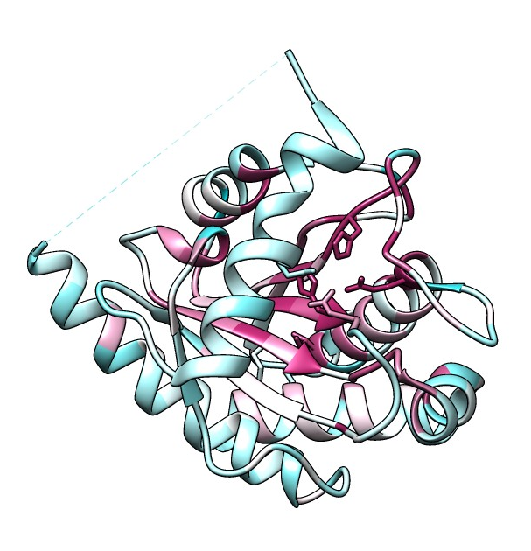
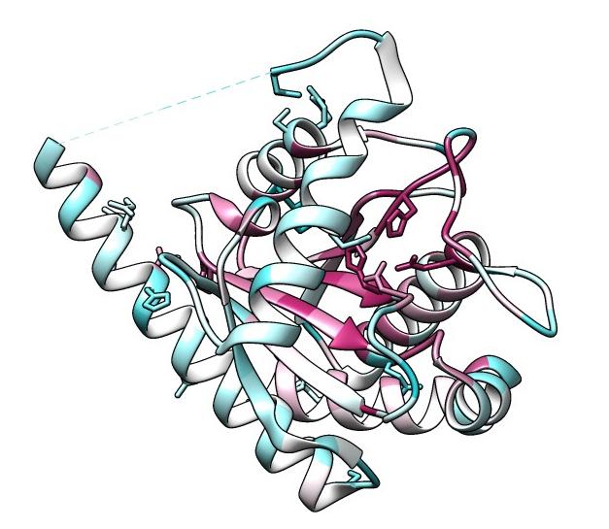
Conservation mapped to structure
Notes:
Blue: Poorly conserved per BLOSUM62 scores, maroon: highly conserved
Left: 3NE8 (Bartonella henselae)
Right: 4BIN (Escherichia coli)

Slide 65
Re-order MSA and sub-sample
JalView has in-built PCA and tree construction ability, started running (but runs out of memory before it completes).
Found in 2024: AncestralClust (2022, Bioinformatics)
- Integrates kalign3 as part of guide tree construction
- Uses neighbour-joining method
- Designed to produces phylogenetic trees for cases where you have very many divergent sequences
However…uses nucleotide sequences, not protein sequences.
https://bmcbioinformatics.biomedcentral.com/articles/10.1186/s12859-016-1112-8 - possible methodology for clustering bacterial sequences for further analysis?
Notes:
AncestralClust: AncestralClust: clustering of divergent nucleotide sequences by ancestral sequence reconstruction using phylogenetic trees, https://nielsen-lab.github.io/pdfs/papers/AncestralClust.pdf
https://github.com/lpipes/ancestralclust

Slide 66
Bounds for possible insertion regions
1% (eyeballing: all low-occupancy regions of >5 amino acids in continuous length)
1-5
73-92 (second, also quite large, present in a few sequences)
140-201 (main, first one identified)
239-250
299-306
Need to: Generate binary vector for each sequence:
[0,0,0,0,0]; n=0 = insertion 1-5, n=1 = insertion 73-92, etc.
Define ‘insertion present’ as non-gaps in >70% of residues within defined boundaries (due to ‘high match’ for 140-201 region correlating with prev. research into gram negative insertion at this region).
Cluster by combinations of these 5 regions (5^2 = 25 possible clusters?)

Slide 67
Bounds for possible insertion regions
0.1% (colour code to roughly map 1% boundaries onto 0.1%)
1-5
23-28
41-46
71-79
95-105, 111-134
200-275
332-336, 341-346
408-416
[0,0,0,0,0,0,0,0]; 8 defined regions (clustering different y/n?)

Slide 68
Clusters by sequence length
(min length: 142, max length: 228)

Slide 69
Sequence annotations
Sub-sample, then annotate with:
Secondary structure predictions
Physiochemical properties
Highly conserved features (conservation >80%?)
Poorly conserved features (conservation <20%?) - likely insertion regions from evolutionary divergence

Slide 70
Conservation mapped to likelihood
ESM1b – tool for human variant effect prediction HOWEVER the output demonstrates possible visualisation of residue conservation at each position in sequence using a heatmap.
Could be feasible to produce for a consensus sequence of ‘amidase 3’ structures?
Get different clusters of features, align these separately, get some consensus sequences, and map conservation onto a heatmap?

Slide 71
Secondary Structure Predictions
“However, model SPOT-1D-LM (2022) is combined with NLM and is supposedly faster – also uses one-hot encoding. But could not get to work as model checkpoints file server is down (and so cannot run the code to completion), and would take far too long (>10mins per sequence)”
NEW: Guide trees back online! So next step: Run this on a set of representative sequences from each cluster (clusters as defined by some sort of tree?)
Notes:
NEW AVENUE FOR 2024: Someone replied to my SPOT-1D-LM query about the model checkpoints! These are now up again! So I can try this at least for a sub-set (eg a representative sequence for each cluster from the guide tree in the MSA?)
Table from the AttSec paper
A lot of models use PSSM rather than one-hot encoding (essentially looking at conservation of the position rather than just sequence information alone), although this is debated as uncertainty how relevant evolution is in the actual protein folding.
Accept: Training datasets contain structures from across species.
SPOT-1D-LM: Citation Guide
for more details on this work refer the manuscript
Please also cite and refer to ESM-1b and ProtTrans as the input used in this work is from these works.

